Slide 1
Notes:
Welcome to [organisation] and to the
[title of the course]!
I am [Name, Surname] and
I would like to say a few words about the European Statistical Programme or for shorter the ESTP

Slide 2
What is the ESTP?
Purpose:
provide European statisticians with continuous training in new methods, techniques and best practices
cover the specific needs of the European statisticians working in national statistical offices of the EU
Notes:
Firstly,
What is the purpose of the ESTP?

Slide 3
Who can attend?
Employees of National Statistical Institutes (NSIs) or Other National Authorities (ONAs) of EU MS, EFTA countries, Eurostat, as well as candidate and potential candidate countries
Notes:
Who can attend the ESTP courses?
Staff of NSIs or corresponding ONAs of EU Member States, EFTA countries, candidate countries and Eurostat can apply.
Occasionally, and on an individual basis, also applicants from other administrations, international organisations and statistical offices of non-European countries may be admitted, if places available.
However, as the groups need to be homogenous, the participants are expected to have a common background in line with the targeted audience, i.e. experienced applicants will not be admitted to trainings for beginners

Slide 4
Are there any training fees?
ESTP trainings are free of charge
Financed by:
However, travel expenses and daily allowances are not covered
Notes:
Eurostat, the Statistical Office of the European Union, is financing the ESTP training courses, therefore attendance is free of charge.

Slide 5
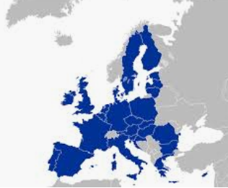
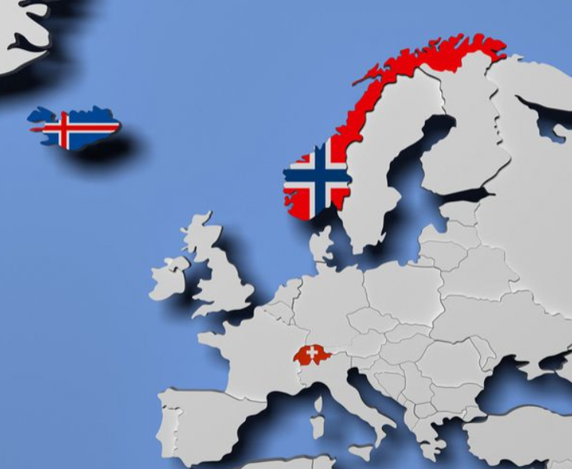
Where do ESTP trainings take place?
Luxembourg
EU Member States
EFTA countries
Notes:
Where are the ESTP courses organised:
The so called ESTP in-house courses, organised by Eurostat, take place at Eurostat premises
The external ESTP courses are organised by Eurostat contractors, often in cooperation with NSIs
Normally, 2-3 ESTP courses per year are financed/organised by EFTA through EFTA NSIs

Slide 6
What does the 2020 ESTP programme include?
Notes:
The 2020 ESTP programme includes:
56 trainings and
7 webinars
With topics covering: data collection, survey methodology, economic and social statistics, data analysis, quality, dissemination and publication, IT applications etc.

Slide 7
Where can I find more info?
https://ec.europa.eu/eurostat/web/ess/about-us/estp
ESTP National Contact Points
All courses’ material are available @ CIRCABC
estat-estp-contacts@ec.europa.eu
ESTP Eurostat team
Notes:
Do you need more info on the ESTP trainings?
Visit the Eurostat website to check the ESTP catalogue. Should you find a training course you would like to attend, contact your ESTP National Contact Points by email. You can find your corresponding one at the end of the catalogue.
All the material for all courses, going back a few years, is available in the CIRCABC and you are welcome to use them for any purpose you see fit
For international organisations or in case you cannot find what you are looking for, please contact [us] @ estat-estp-contacts@ec.europa.eu
Eurostat’s [our] team will be happy to help you!

Slide 8
Course logistics
Attendance list to be signed every day
Certificates of attendance distributed
the last day
Notes:
Dear Contractor, if there is a lunch or other social event organised for the participants to be mentioned at this point.

Slide 9
Your opinion matters…
Fill in our e-survey to help us improve
Notes:
Please help us improve by filling in the e-survey which you will receive by email by the end of the course.

Slide 10
Thank you and….

